Slide 1
Data Structures
Lecture 13
Tree Problems
Prantik Paul [PNP]
Lecturer
Department of Computer Science and Engineering
BRAC University

Slide 2
Tree Problems
Check if Two Binary Trees are Identical

Slide 3
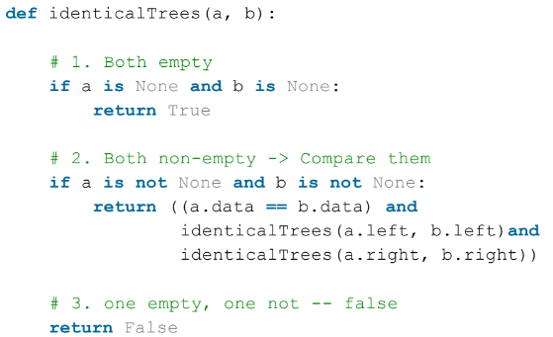
Tree Problems

Slide 4
Tree Problems
Check if a Binary Tree is Balanced

Slide 5
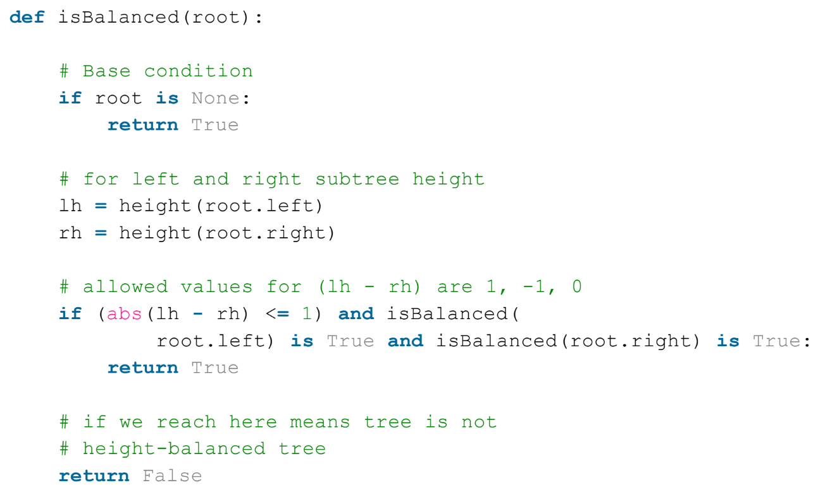
Tree Problems

Slide 6
Tree Problems
Check if a Binary Tree has Duplicate Elements

Slide 7
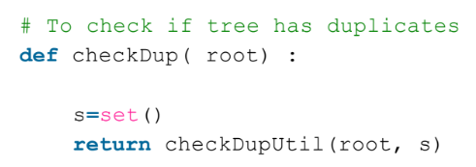
Tree Problems

Slide 8
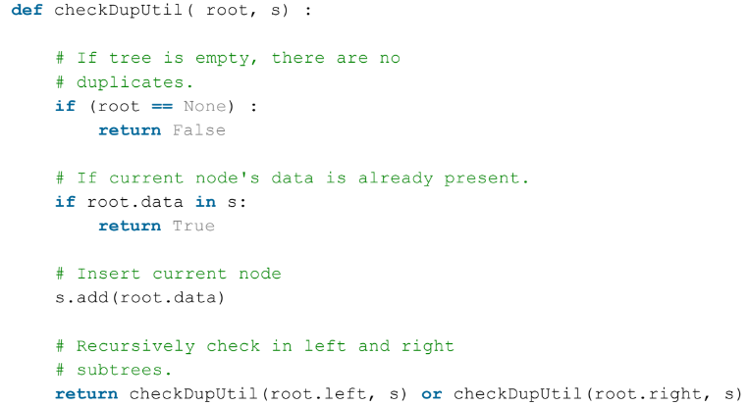
Tree Problems

Slide 9
Tree Problems
Find the Unique Elements in a Binary Tree

Slide 10
Tree Problems
Find the Duplicate Elements in a Binary Tree

Slide 11
Tree Problems
Find Occurance of an Element in a Binary Tree

Slide 12
Tree Problems
Find Occurance of All Elements in a Binary Tree

Slide 13
Tree Problems
Check if a Binary Tree is Skewed
each node has only one child node or none.

Slide 14
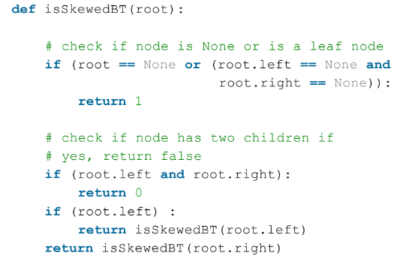
Tree Problems

Slide 15
Tree Problems
Print all the Full Nodes of a Binary Tree
both left and right children are non-empty.

Slide 16
Tree Problems
Print all the Nodes with 1 Child of a Binary Tree

Slide 17
Tree Problems
Given a BST Print Elements in Descending Order
Do yourself

Slide 18
Tree Problems
Given a BST find Kth Largest Element

Slide 19
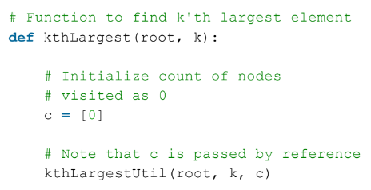
Tree Problems

Slide 20
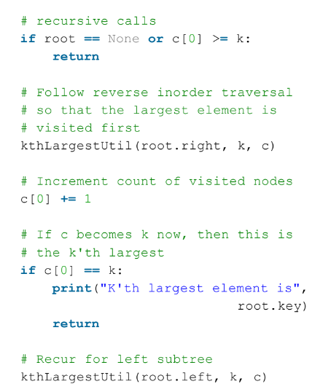
Tree Problems

